Slide 1
Sharpening by Intentionally Dulling
David Weaver
7/23/2022

Slide 2
Summary of Topics Covered
What is the real objective here? Sharpening things quickly and accurately, as well as:
  Making substandard tools work better
  Making good tools work better
  Moving toward honing only wear and not damage
Who am I? Does it matter when you can observe the results of the method easily?
What is sharpness? The concept is simple but not as rigid or geometrically ideal as you may think. Where do people usually come up short when sharpening?
The basic Unicorn method. It’s ideal for chisels and gouges.
Some pictures of its effect and corresponding testing
Equipment needed (never expensive!)
Safety – especially with knives. It’s your responsibility. Be smart.
Tips and other comments, commentary on grab bag of pictures. And Questions?

Slide 3
The Objective – Eliminate Routine Damage but No Performance Concession
The objective is to eliminate edge damage, but to do it in a way that is both easy to execute and that is fast and inexpensive.
  Easy to execute and fast are relative terms. Feel methods are often faster and easier.
  Eliminating edge damage lengthens the use interval before resharpening.
  A wider range of tools is suitable. Most plane irons will plane clean wood suitably, but no chisel will chisel hardwood damage-free with a 30-degree final bevel. 35 degrees will usually solve the issue but feels dull – lots of cut resistance and chisels bounce out of the cut.
    Eliminating damage poses another question. How mediocre can a tool be?
  There should be no concession in sharpness or effort and you should be able to prove it in use. Initial sharpness may seem similar, but preventing damage creates more separation the longer you work.

Slide 4
Who am I? Am I a Professional?
It shouldn’t really matter if you can try this for yourself and see the outcome, but..
I am an amateur woodworker and toolmaker, and when shaving, straight razor user. I will sharpen everything I can find but don’t favor inflexible or slow processes.
Sharpening is a non-verbal process. Taking appropriate steps and following them becomes what feels right. Feel is faster to process than thought.
I try to work mostly or entirely by hand if making allows. Some projects don’t allow it, but many things do. I’m not a re-enactor.
I will experiment while making, in general. 10% of time spent experimenting yields more efficiency gained than time spent.
There’s no legacy issue and no profit motive – I’ve never invented anything or netted a profit. Discoveries yield the opportunity to identify to see who did this before you did and solve older mysteries. Each layer makes the next easier.

Slide 5
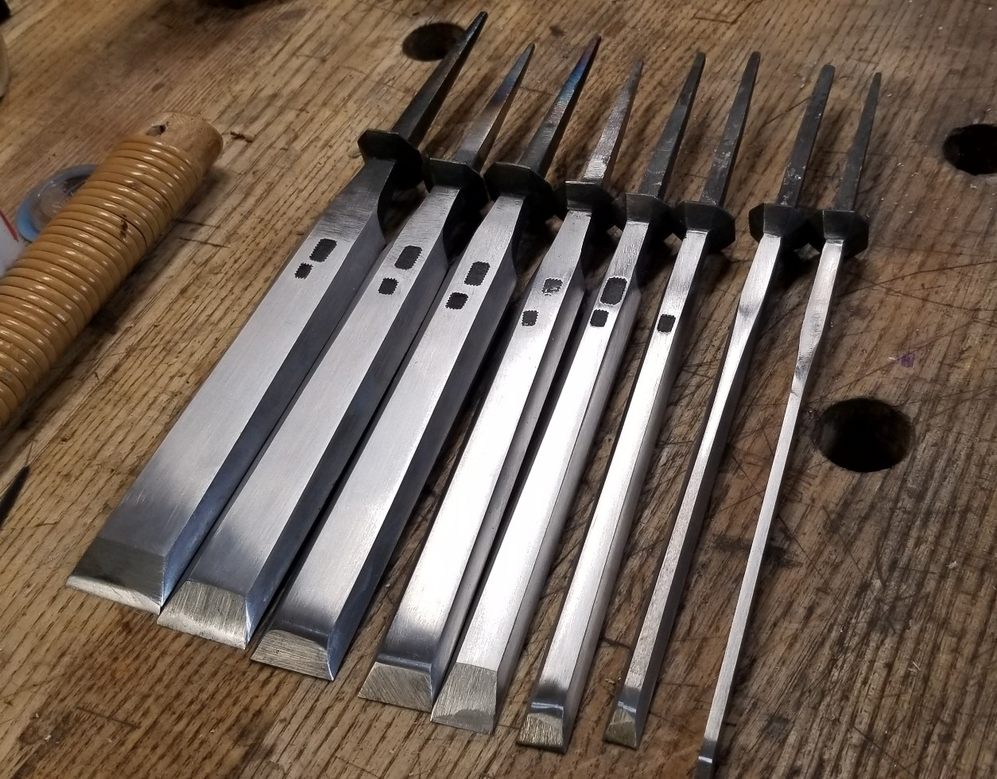
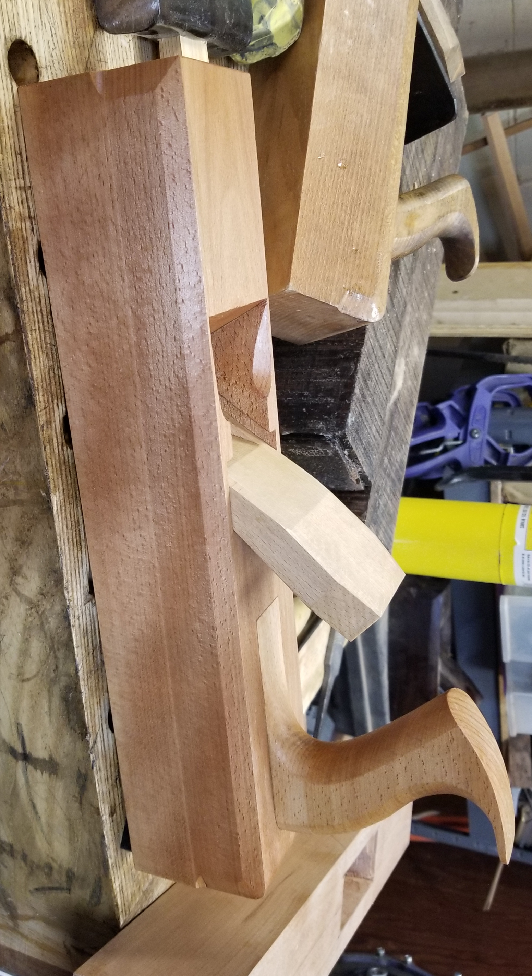
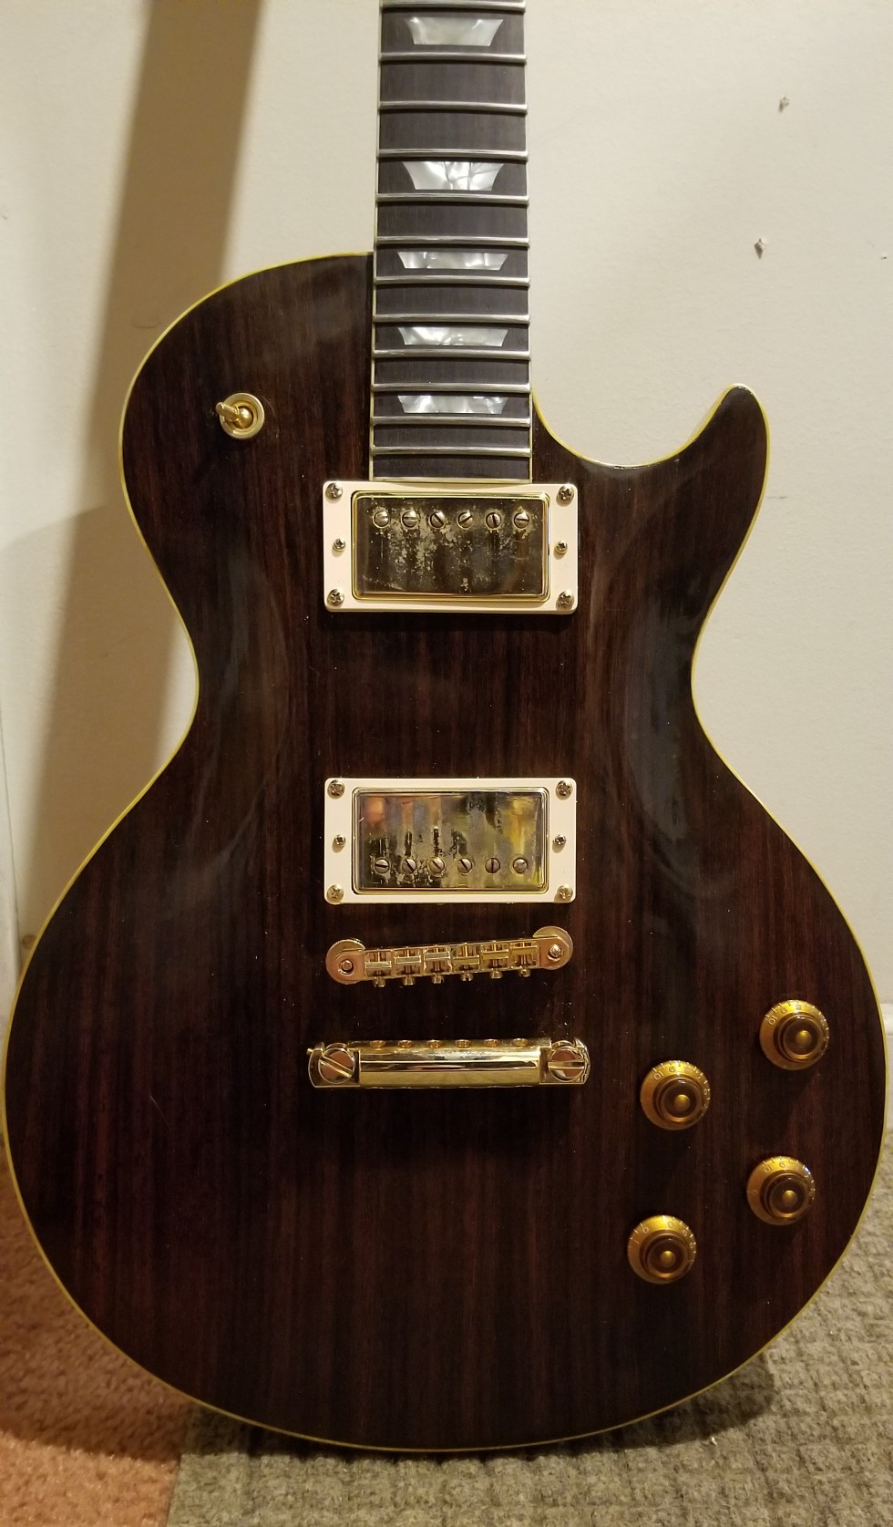

“Do you Make Anything?” Examples of Things I’ve made

Slide 6
What is Sharpness?
The simple definition given to woodworkers is two perfect planes intersecting
  There is truth to this, initial sharpness can be great.
  Edges have an apex. The basic sharpness definition is great if apexes fail by wear (rare).
  Unfortunately, a lot of sharpening effort is repairing damage.
  The damage usually occurs in the first four to five thousandths of an inch of an edge. If not, something else is wrong.
Sharpness in general is a more nuanced concept
  In woodworking, we usually do two things – sever and wedge.
  Planing, we do the same but the impact of both severing and wedging is less.
  Sharpness example in straight razors: the perfect apex leads to problems. Barber linen and leather wears very small amount of the apex to a rounded shape. The steel should be too hard to align any deflections. Once this is understood with a straight razor, hundreds of shaves are possible before resharpening. The thin bevel is fine because he damage only occurs starting in the apex.

Slide 7
Practical Sharpness Pitfalls – that I’ve Seen in Person
Not finishing the job – fine scratches fail to get to the edge. It doesn’t matter how fine the final stone is if the edge and stone have never met each other.
Obsessive polishing of large volumes of steel.
Geometric problems – especially the urge to chase bevels steeper.
Inability to find how a tool needs to be accommodated to avoid damage – too shallow instead of too steep.
Inability to cope with burrs.
Choosing a method and working through the method, regardless of the situation.
Never observing results – a $25 handheld USB microscope will tell you everything. Even your cell phone and a loupe may be enough. A loupe by itself can identify really large problems, but less effort and better results rely on things occurring at a very small scale.

Slide 8
The Basic Method – the Unicorn Method for Chisels
This is a feel method. Pictures only ever became necessary to address questions that don’t need to be answered. “How many thousandths of an inch at what angle?”
Steps - for a chisel:
  Grind a primary bevel of about 20 degrees – not too shallow or you’ll fall into a trap. Only grind when the next step becomes hard to complete.
  Hone a secondary bevel around 2 or 3 degrees steeper. When refreshing an edge, rehone the entire edge back to a flat secondary bevel (remove the work of the buffer completely – every time)
  Buff the bevel of the chisel in question back and forth across a stitched cotton or shellac cotton buffing wheel (not felt, not leather). Hold the chisel with the bevel against the wheel and then steepen the angle and push the chisel with some pressure into the wheel.
  No buffing on the flat back of a chisel.
Check the safety notes later in this presentation before trying.

Slide 9
Why Does this Work?
Damage usually occurs in the last 4-5 thousandths of an inch. Modifying the apex makes it harder for damage to start.
The modified apex still severs fibers well. The buffer helps to complete the job and the rapid edge degradation that occurs quickly with a crisp apex is gone.
Wedging behind the apex is reduced by using shallower primary and secondary bevels.
  If you do see damage well into the secondary or especially into the primary bevel, then they need to be steeper. I tried 15 degrees with Footprint chisels – catastrophic damage.
The buffer handles the burr – within reason. Ever hear people talk about how sharp Japanese chisels are? The lack of a fine burr is one of the reasons. It’s satisfying to really understand manipulating and eliminating burrs, but the buffer does it well and fast.

Slide 10
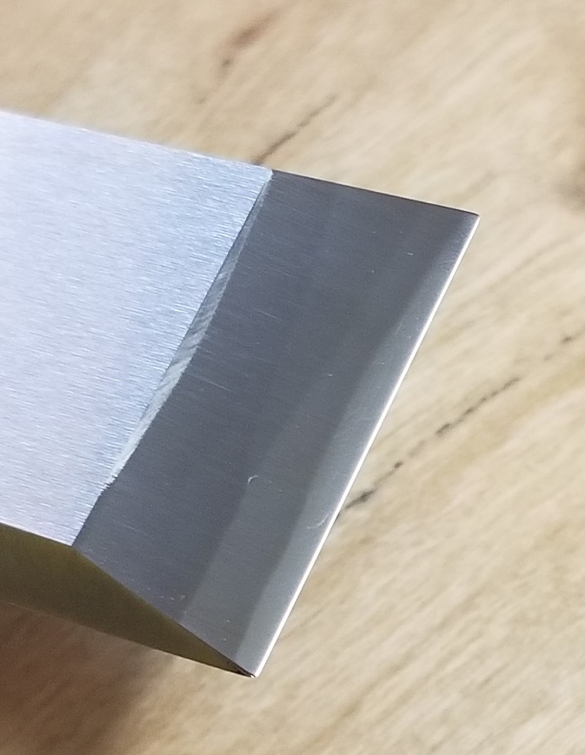
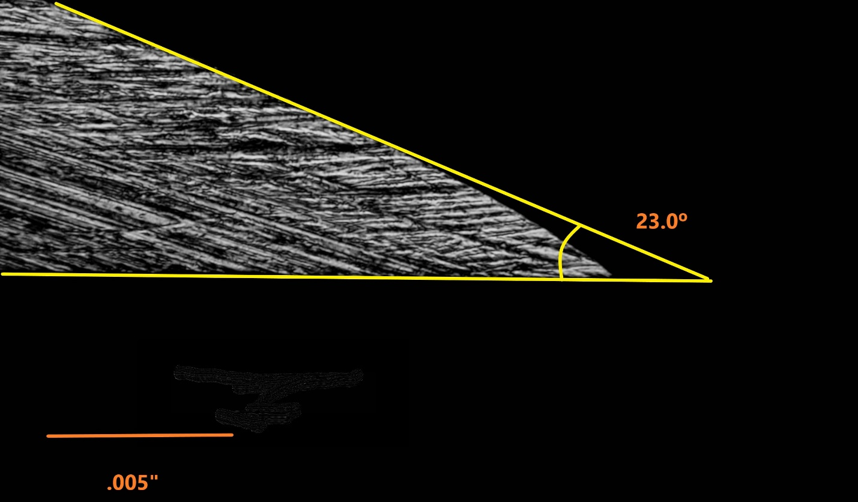
What does the profile look like after the buffer is done? On chisels…..
This picture shows a Sorby chisel. There are always people who want to know what they’re going to see. It will look like the shiny reflection on the picture on the right – just at the tip of the chisel. Why do we all love thousandths so much?

Slide 11
A Case Study – Testing Various Chisels in Maple
A question should arise – which fares better, an expensive chisel with an apex or a cheap chisel with the edge modified? If the latter, what does this imply?
I tested this method on four chisels while looking at this originally because it didn’t seem like any chisel failed easily once the apex was modified.
The conclusion was that understanding geometry is more important than the quality of the chisel after a point. I would categorize chisels in quality levels:
  Lowest – hardware store, soft
  Low-middle – softer chisels that fare well in easy woods, but not well in others (R. Sorby, Marples Blue Chips, etc)
  Middle, to upper middle –some vintage English tang chisels with octagonal bolsters, V11 (what!?!), Ashley Iles, etc.
  High-end - good quality Japanese chisels and better vintage English chisels
If you like lower and low-middle quality chisels, you can make their edges last.

Slide 12
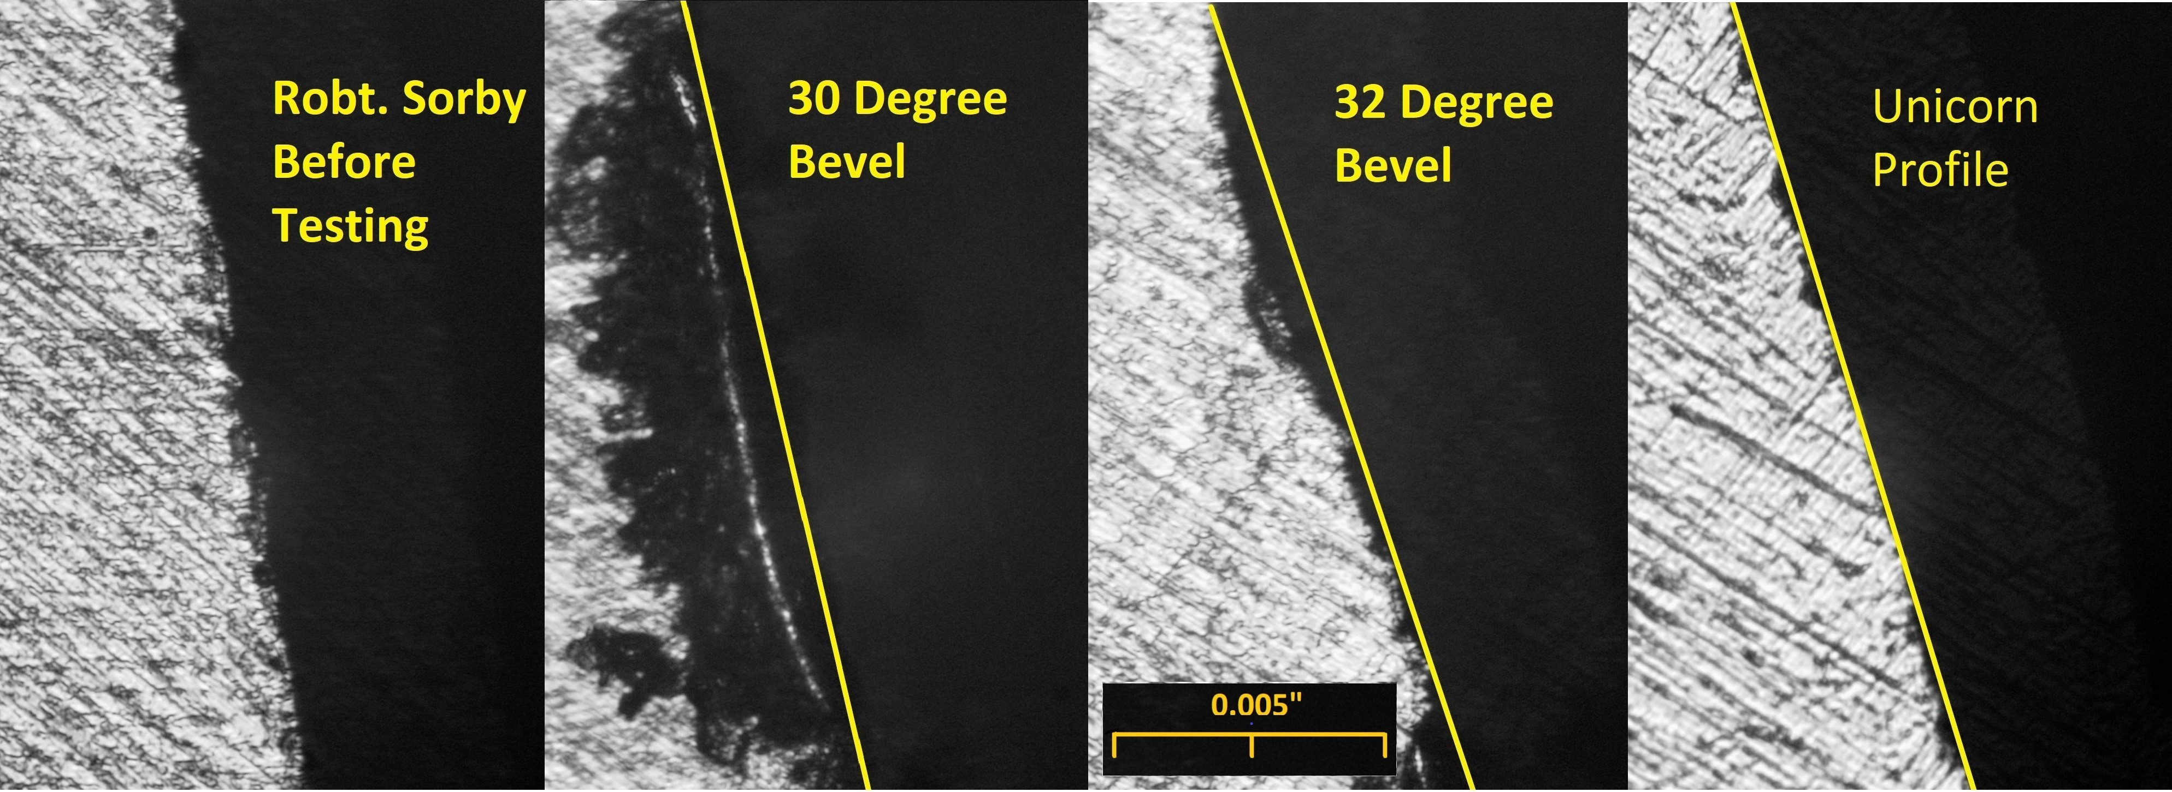
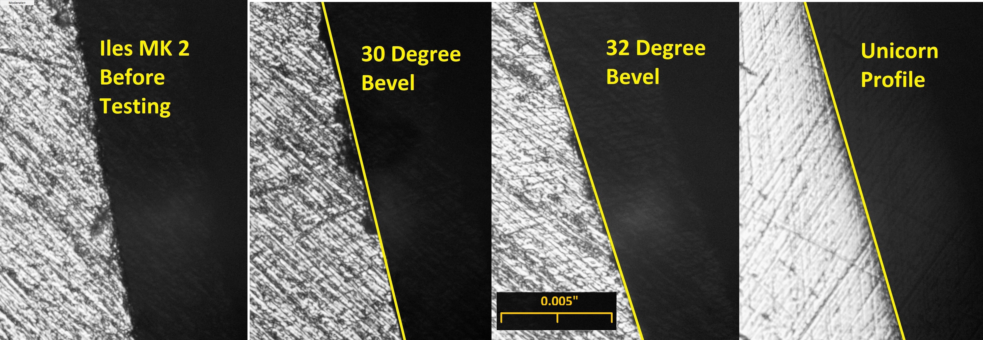
R. Sorby and A. Iles Mk 2
Pane 1 – freshly sharpened
Pane 2 – 30 degree bevel
Pane 3 – 32 degree bevel
Pane 4- Buffed (Oops on the back of the Iles chisel)
All chiseling done in the same maple board.

Slide 13
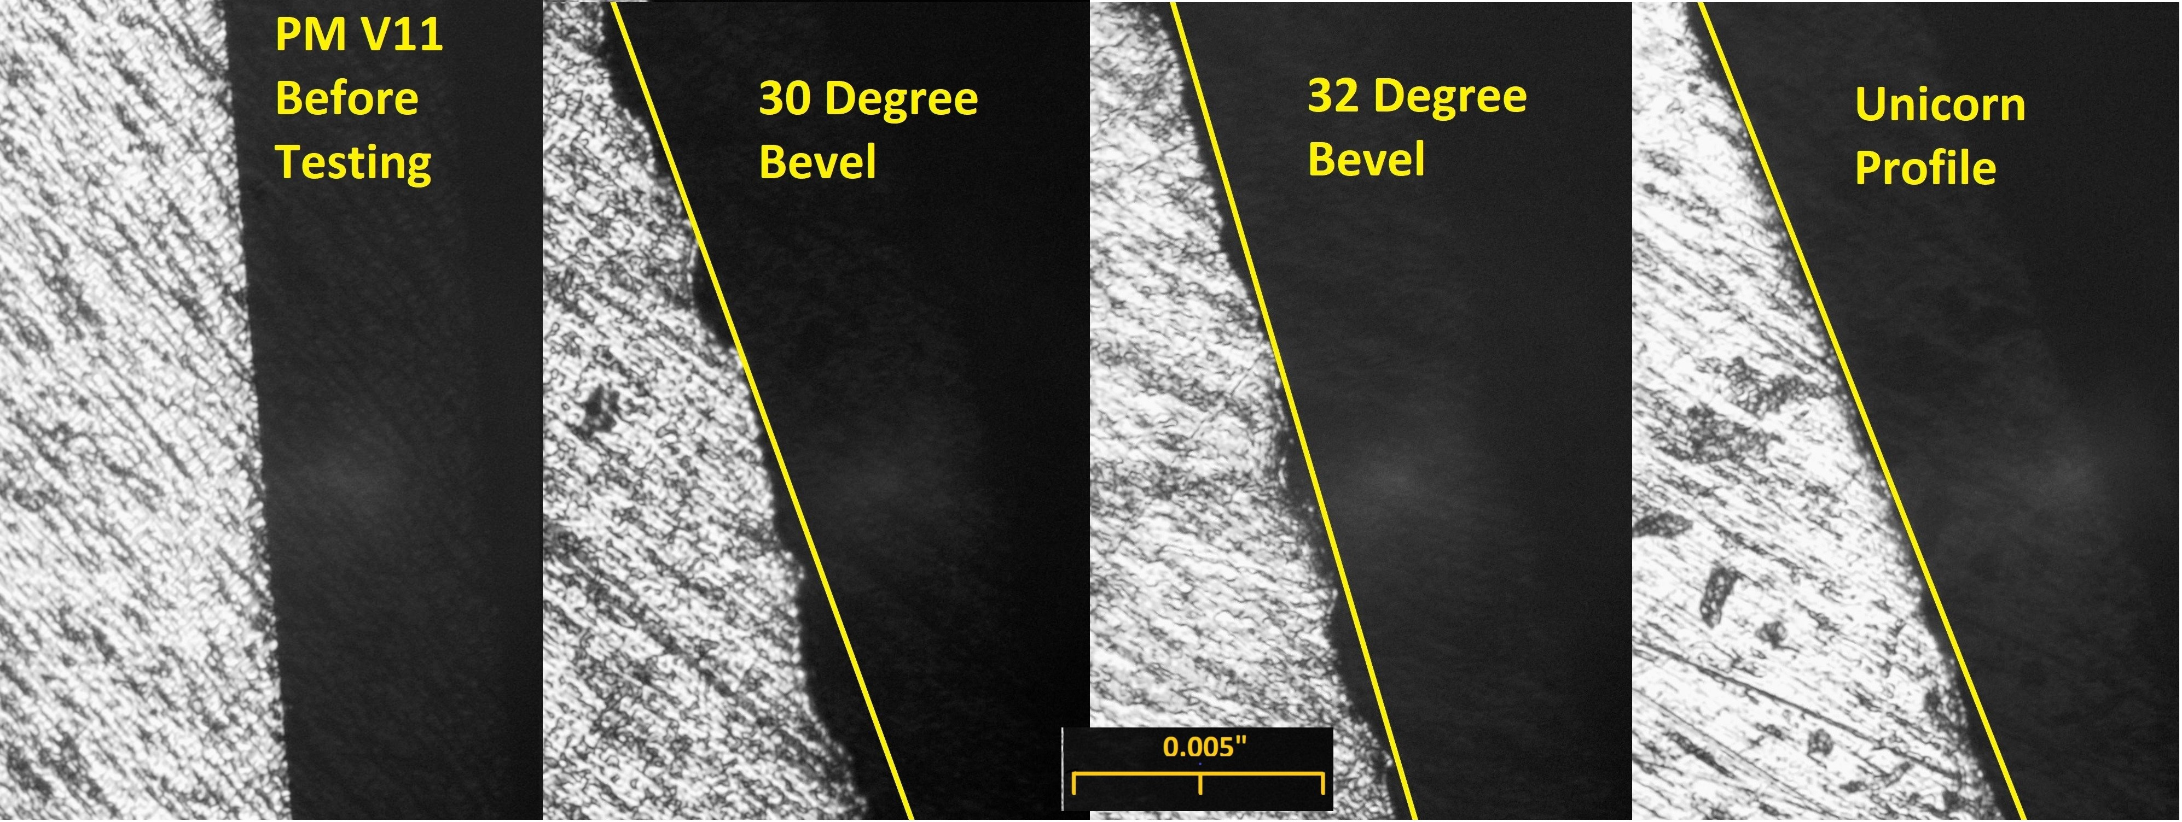
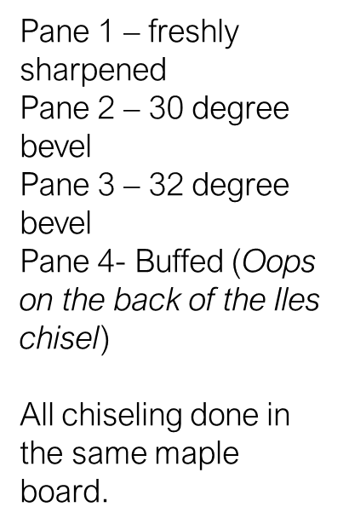
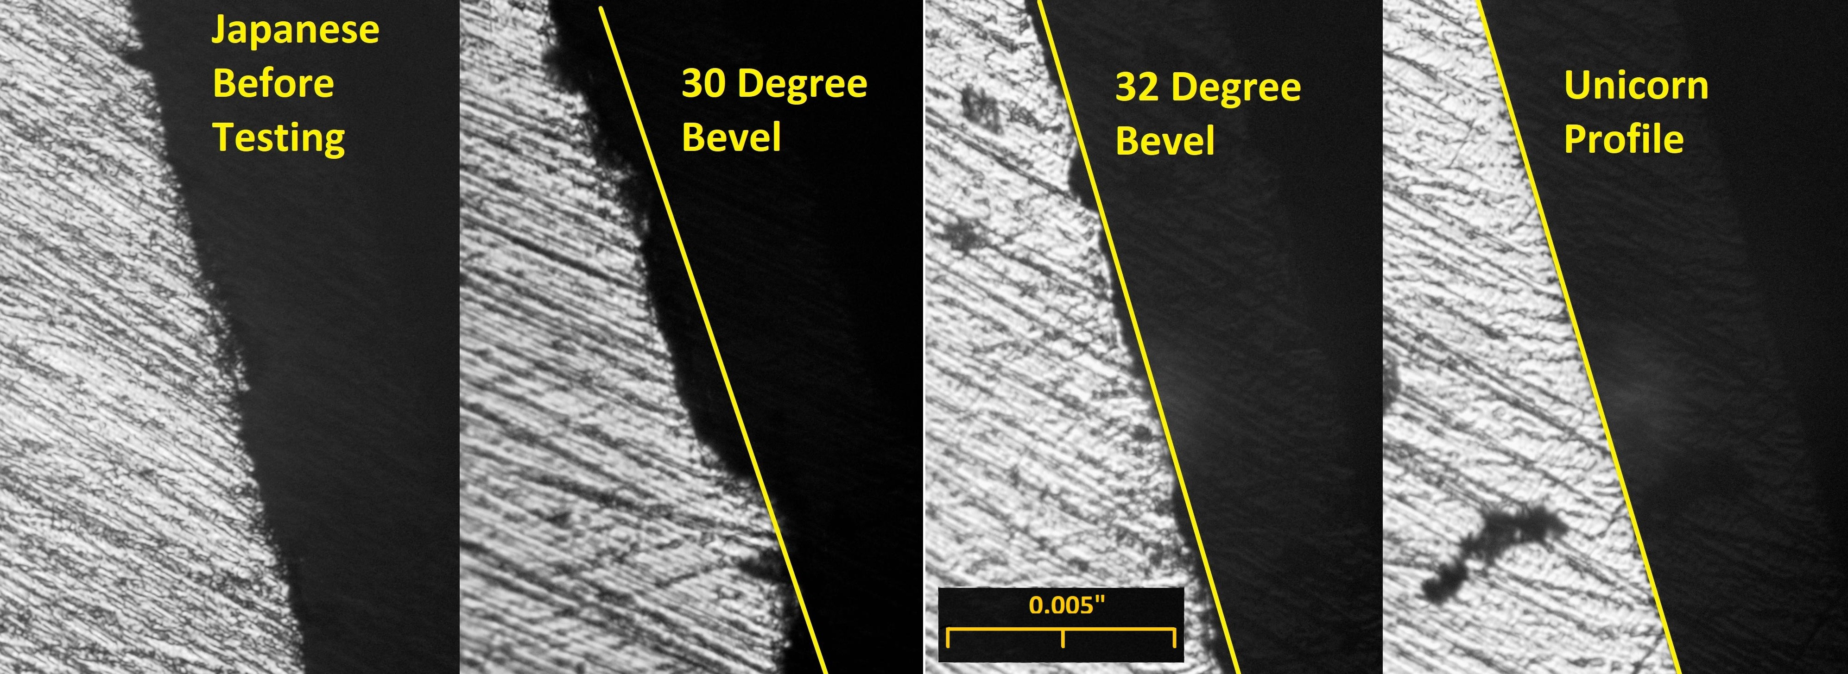
PM V11 and Japanese White Steel

Slide 14
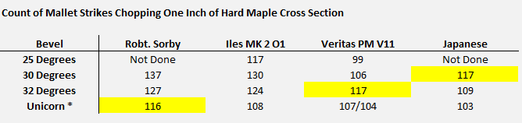
Data and Conclusions from Chisel Edge Testing
Chart numbers below represent strikes needed to chop a volume of hard maple.
Strikes are part of the story, but time spent is greater than difference in strikes.
It looks like a case can be made for 25 degrees, but damage was catastrophic and a longer volume of work would change overall results
A more pleasant wood would be les demanding (mahogany, poplar, …). But you can also buff less on softer woods and have a thinner apex.
From experience, if damage occurs in maple, it will usually occur in wood like cherry a little more slowly.

Slide 15
Diversion – What other Tools?
Knives – but remember that you’re buffing on both sides. Half of the effect on each or you’ll find an edge that’s too rounded. Everything that looks like a point must tend toward the wheel's direction of rotation. No slipjoint knives and never hold your fingers under a blade.
Plane irons – GREAT for bevel up planes. A heavy buffing of the edge acts like +5 degrees of bevel angle. For bevel down planes, buffing only the bevel side is limiting clearance – that is, the orientation of the apex into the wood. Buffing can be useful to limit damage, but the touch is trickier. Remember to start with a slightly lower angle and if you find no success, consider using the buff more like a finish stone more lightly on the bevel and very lightly on the corner of the buffing wheel on the back of a blade. Adding steepness to the flat side of a blade just makes planing harder.
Carving tools - of course, a large part of the carving population has done some version of this for a long time. I suspect the Koch system does this a different way, but could never find much documentation.

Slide 16
What Equipment?
A 6 (or 8?) inch buffer. 6-inch high-speed and 8-inch slow-speed single speed machines typically have the same linear speed. Can you use a grinder? Not without completely removing rests and all guards!! The buffer is still better thanks to the clearance afforded by the long arbors. The 6” harbor freight buffer is fine. Any 8” high/low speed probably is, too.
Cotton stitched wheels or shellac coated cotton, about ½” wide with stitching near the edge.
A grinder of some sort (for grinding). You can do this without a grinder, but a grinder or grinding system of some sort is nice. Accurate grinding is part of setting the stage.
A medium stone for the secondary bevel (1000-2000 grit synthetic equivalent) and something fine for the back side of a plane iron. However, you can live without the fine stone if needed. Even an inexpensive fine india stone should work well.
Some type of buffing compound. My favorite is 5-micron buffing compound, preferred above the very small abrasive buffing bars. The buffing wheel has no harshness, so particle size is misleading. 5 microns in the buff is finer than an 8,000 grit waterstone.

Slide 17
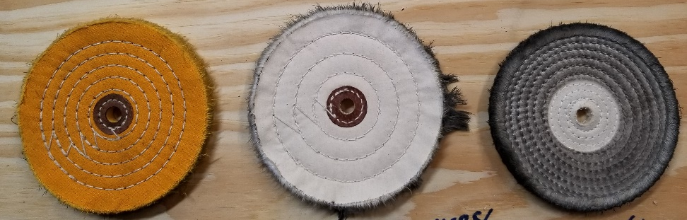

Equipment
Pictures of the equipment are below. White, yellow and green buffing bars work well and are everywhere. Avoid blue (for plastic), rouge (iron oxide for softer metals), and black (coarse abrasive) or tan (silica) .

Slide 18
Safety Considerations
Everything you do should be introduced to the wheel on the bottom where the wheel is traveling away from you. If you stand behind the buffer, this would be the top going away.
Anything that’s flat with an edge (like the top of a knife blade) where the spine can get into the wheel requires extra care.
If you buff a knife, make sure he knife can’t close and make sure that anything that remotely resembles a point is fed so that the point travels with the wheel. Otherwise, the wheel will instantly snap it from you. You may break fragile blades that catch, and never have fingers under the blade when buffing.
My preference is to stand on the buffer frame and use it on the floor. The foot weight is handy and you’re above the action and never under it.
Safety is your responsibility. Start slow.

Slide 19
Tips to make this work better
The buffer makes heat, don’t leave anything in it too long.
The center of the wheel on the buffer is the stiffest. You can also use the corners. Speed is dependent on wheel location and pressure.
Refresh the buffing wheel often – buffing bars are really cheap (the 5 micron yellow bar is currently $13 for 3 pounds. You’ll break it before you ever use it).
When the wheel loads, use thin steel or something similar to remove caking.
A new wheel will release fuzzy strings. This won’t last long.
The wheel can sling some compound, but the compound is dry and it’s not dusty like grinding wheel abrasive.
When preparing the edge for the buffer, thin the wire edge as much as possible.

Slide 20
Answers to other Questions
Can you use felt or leather? Not at full buffer speed. They will batter and burn edges and especially in the case of leather, can grab a tool and send it away at high speed. Ask me how I know this. You can use these at low speed, but the buffer works better with a stitched wheel at high speed.
Felt, MDF and leather are fine at slower speed, but there’s no need to make things difficult or expensive.
Can you do this with a stone or a strop?
  Yes – if you do it, do it with an ultra fine or fine and very slow stone as the last step, roll the profile into whatever tool you’re using. I started rolling the tip on a specialty stone that’s similar to a spyderco ultra fine. The buffer does it better.
  Strop instead? You can use a leather strop, but strops are more sensitive to contamination than buffs. It will take a long time to hand strop this profile into an edge. You can try hardwood instead with the buffing compound, or use the buffing compound standalone on hardwood by adding a drop of oil or WD-40 and scribble the hard bar into the drop of oil.

Slide 21

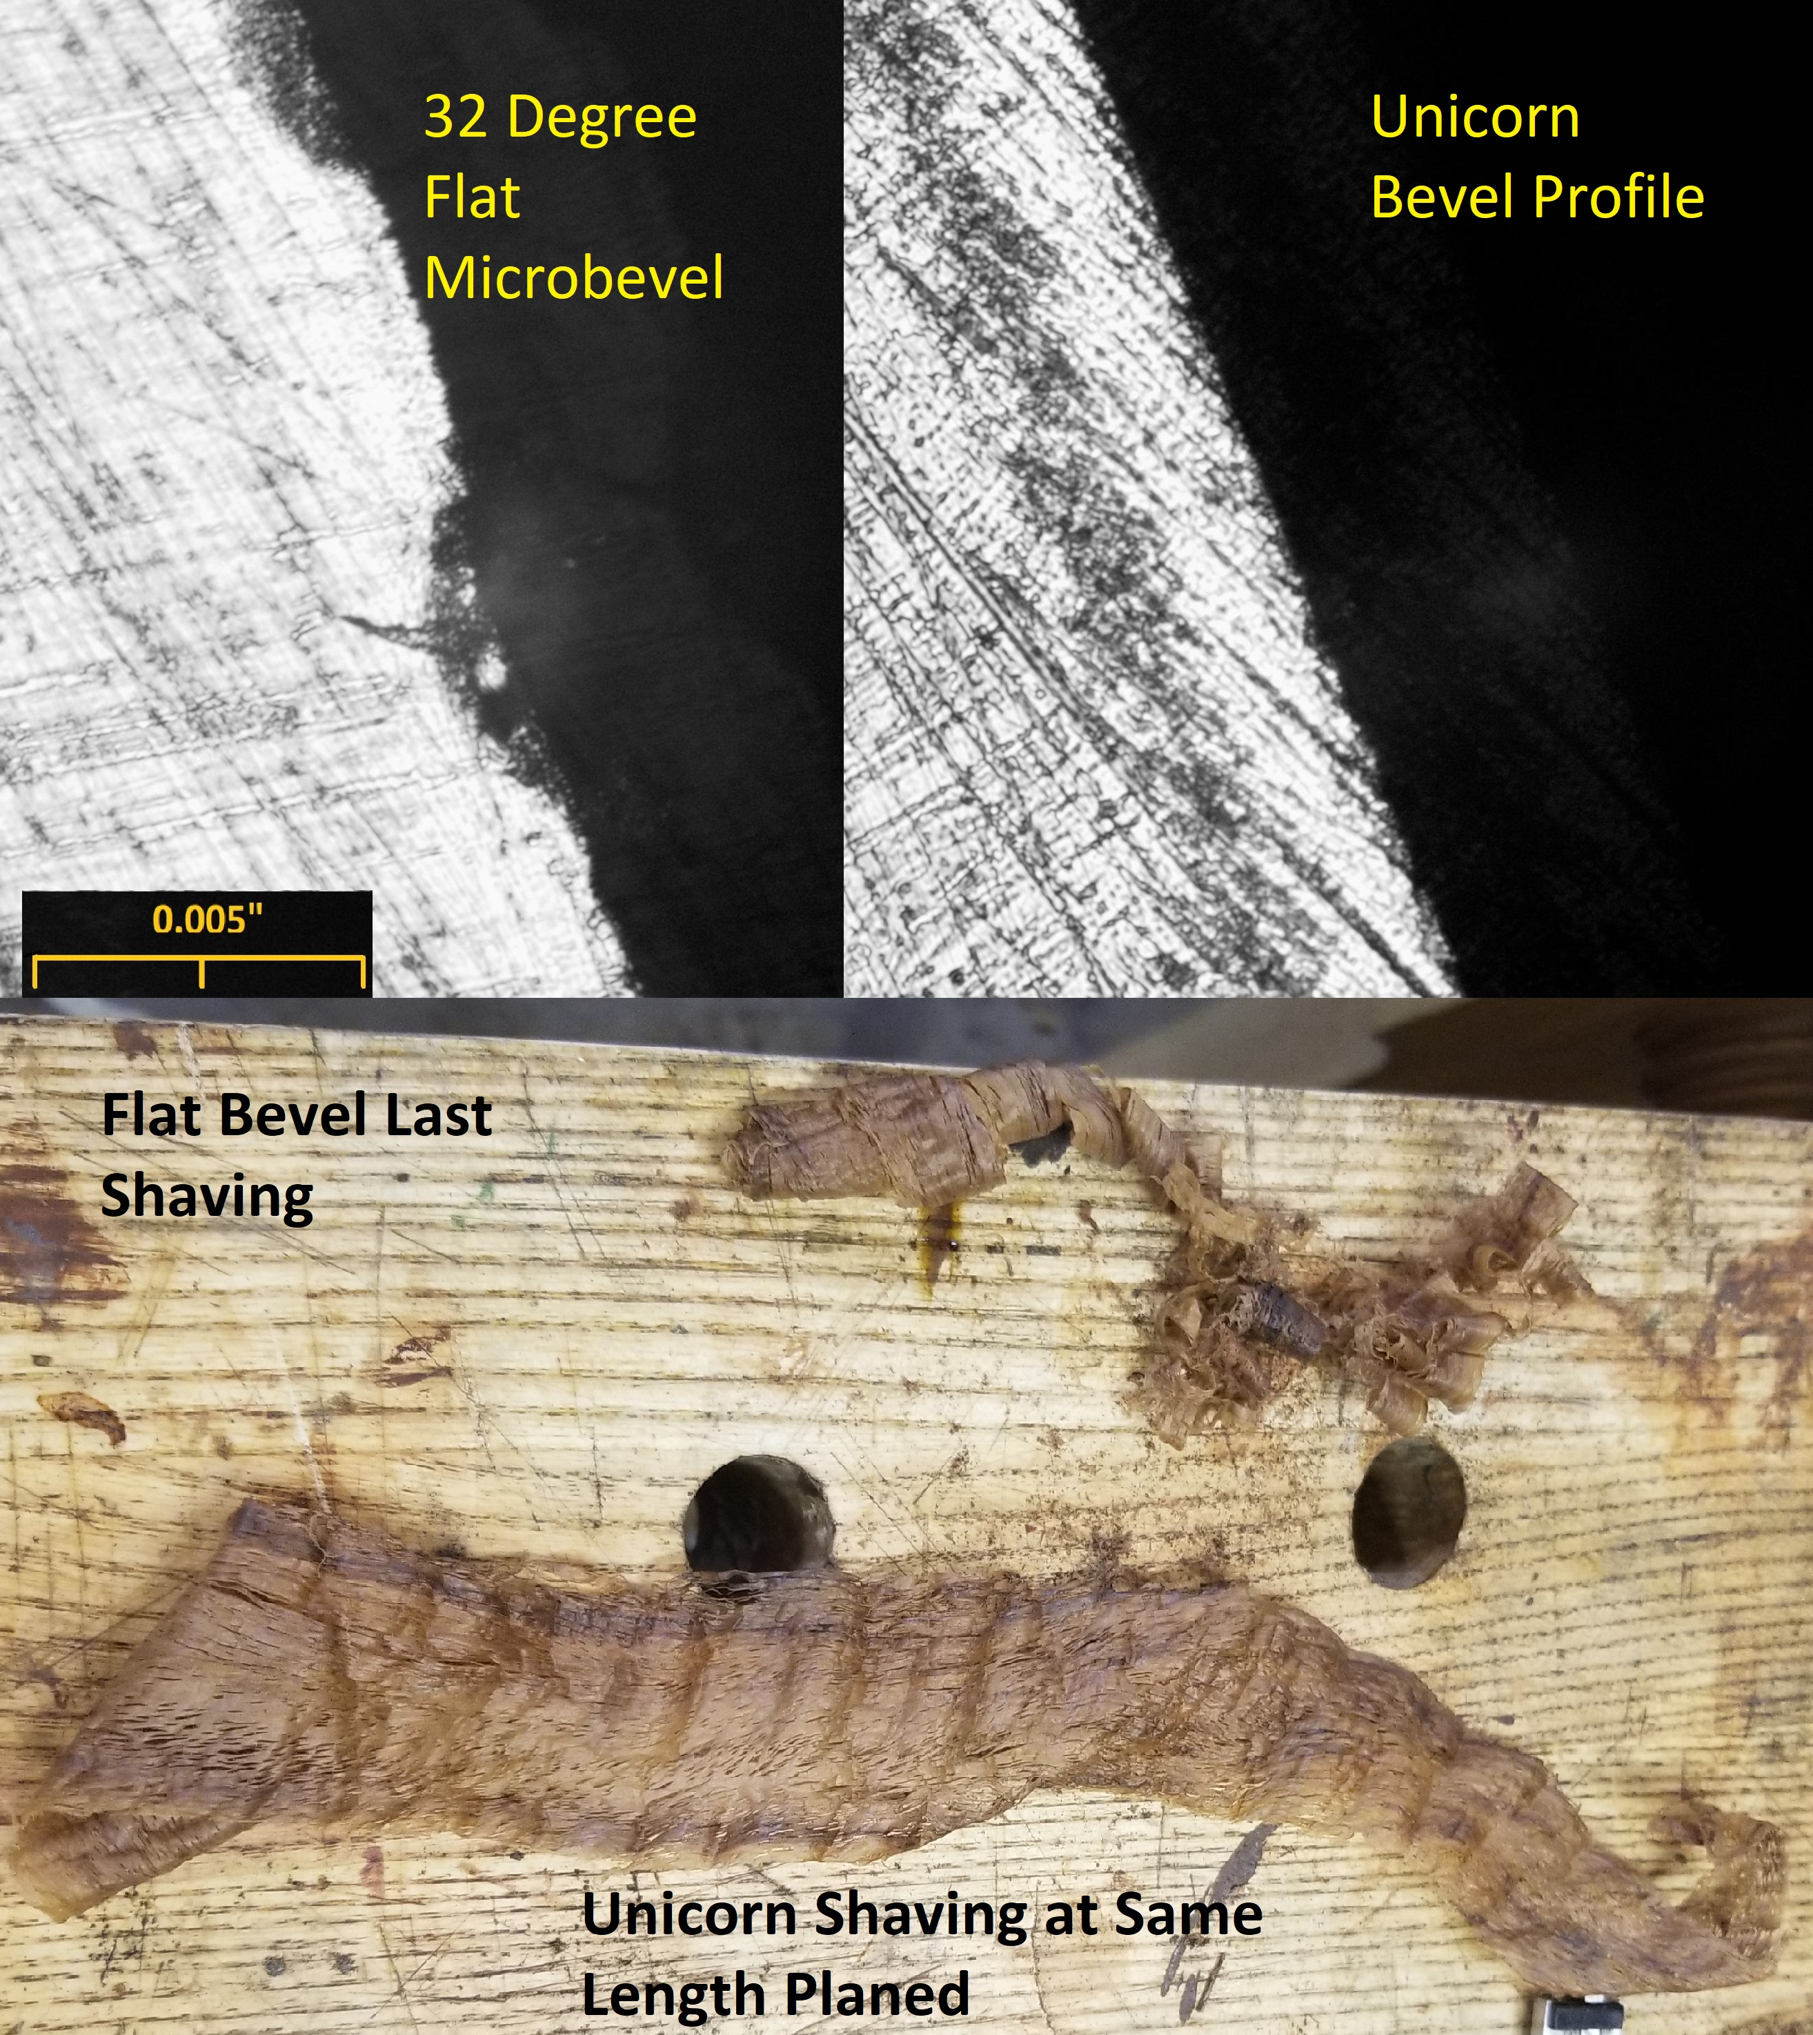
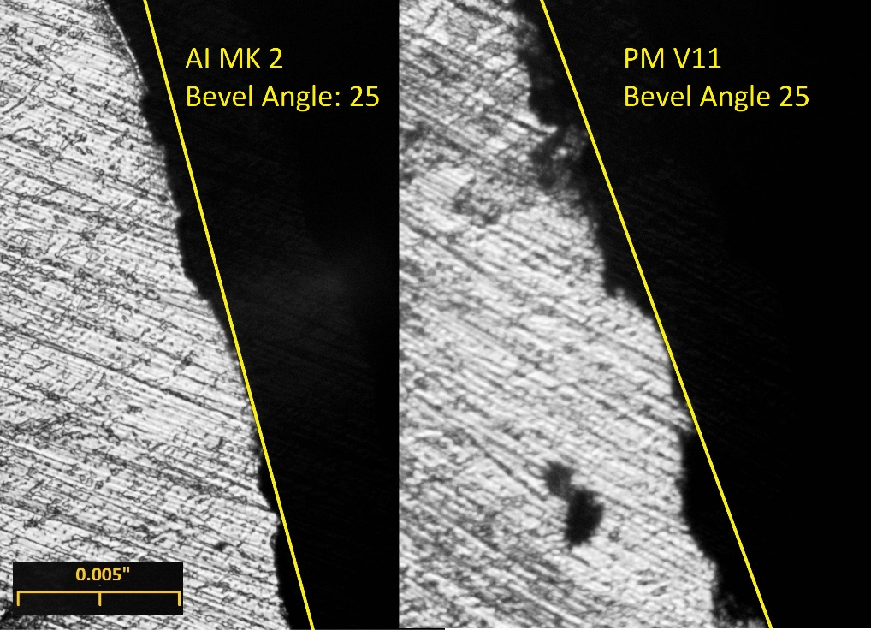
A Few Other Pictures for Discussion

